Slide 1

Project work Analysing historical data of hydrocarbon production on the Norwegian Continental Shelf
05.2021, Eniko Varkonyi

Slide 2
Loading of the data
In order to load the data I used the csv reader.
The les_prod_data function has one parameter, which describes which column of the csv file the user would like to take. The function takes this column, replaces the original ‘,’ separators with ‘.’ and creates a list from the numbers.

Slide 3
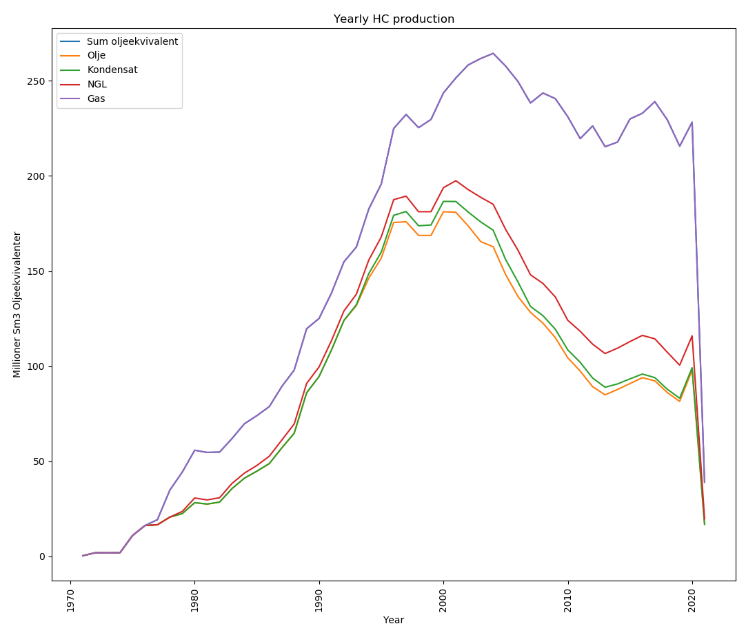
Visualization of data
To visualize the data I used the matplotlib.pyplot library.
The plot_produksjon function takes the different columns of the csv file (with the help of the les_prod_data function) and plots them on the same graph. In order to achieve an easily readable look, the production of the different HC products are plotted on top of each other (this is why I summed the different lists).
(See last slide why values on my graph are different from the example graph on Inspera)

Slide 4
Data analysis
To analize the data I created 3 functions.
The functions take input from the user about the HC product the user would like to analyze and the time period in which the analysis should be made. Based on the product name, with the help of the les_prod_data function, they take that column of the csv file which corresponds to the given product. Based on the given years they determine the indexes these numbers belong to in the aar list, and then apply these indexes on the list of the product in question. So that the list of the HC product is filtered only for the given time period.
The functions:
The beregn_gjennomsnitt function calculates the average production of the HC type for the given time period,
The finn_maks function calculates the maximum production of the given product. This applies for the full time period, it doesn’t take into account the given time period,
And the beregn_areal_trapz function calculates the produced percentages of all the products for the given time period.

Slide 5
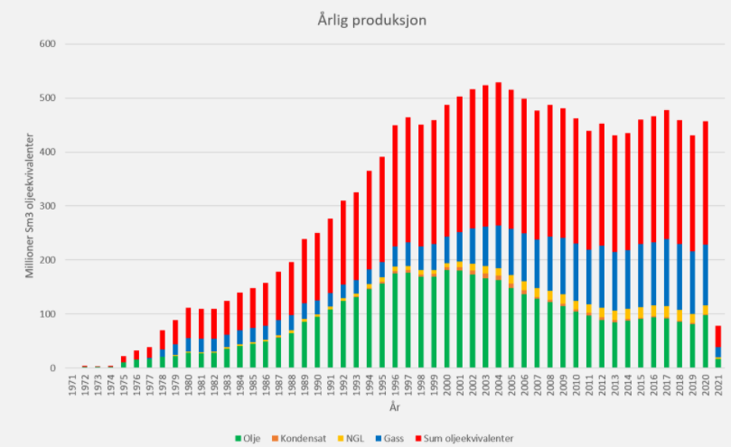
Notes
Things I couldn’t solve / don’t understand:
1. When running main i wanted the graph to pop-up before asking for user input, but I couldn’t solve this.
2. I wanted the graph to remain open when the statistics are shown, however I couldn’t solve this. The graph blocks the code to continue, so it has to be closed.
3. In the task description on inspera it’s indicated that all functions should’ve been called with the ‘aar’ list as a parameter, however I don’t understand why it’s necessary, I’m not sure whether my functions are good without it or not.
I think the graph given as example on inspera is maybe incorrect, as according to this picture the max of the sum of oil equivalent should have been higher than 500 SM3 o.e., but if we take a look at the data, it wasn’t that high, I think the red columns actually represent all the products summed together, so they shouldn’t be again added on the top.

